Slide 1

Document Object Model(DOM)
D --> Document
O --> Object
M --> Model

Slide 2

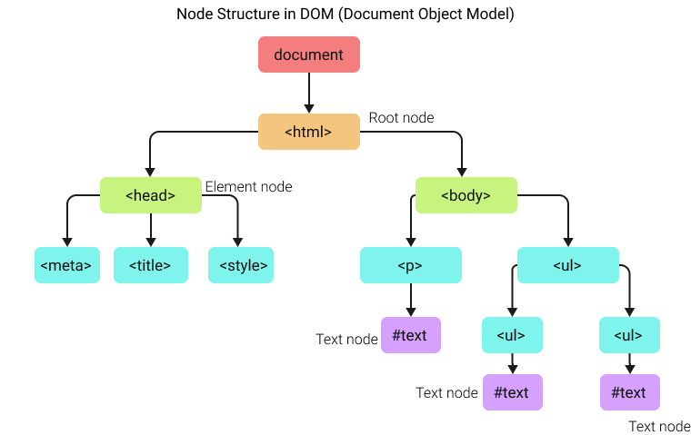
HTML DOM Node Tree (Document Tree)

Slide 3


Interface

Slide 4
What is DOM ?
Dom is a Document Object Model and Programming Interface that defines HTML objects, properties, methods and events to get ,changed ,add or delete HTML Elements

Slide 5
What can do JS with DOM
1.change HTML element
2.change HTML attributes
3.change CSS style
4.add HTML elements & attributes
5.remove HTML elements & attributes
6.react to HTML events

Slide 6
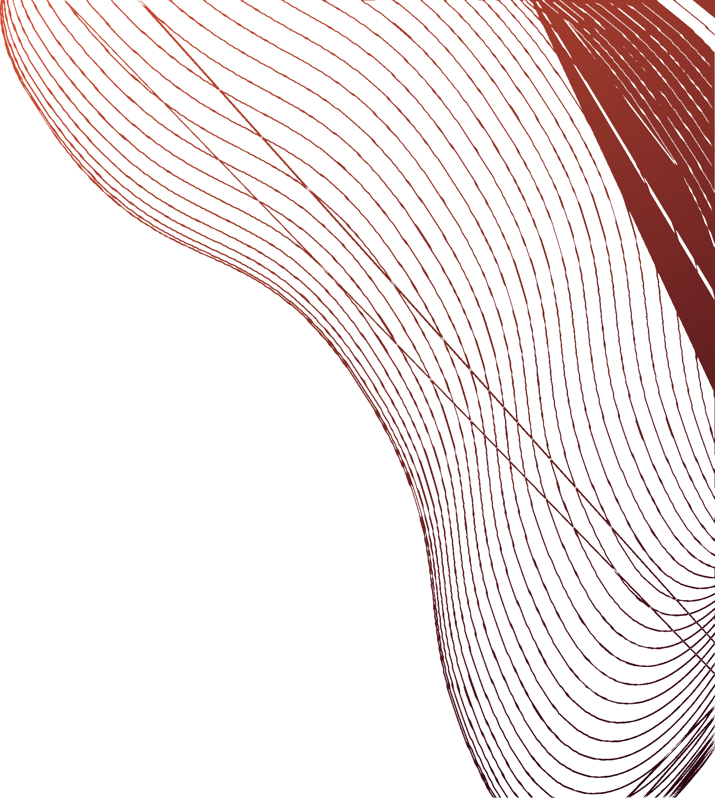
Traversing Dom
1) getElemnetsByTagName method
2) getElementsByClass method
3) getElementById method
4) getElementByQuerySelector, querySelectorAll method

Slide 7
Dynamic style – manipulating CSS with JavaScript
Add and Remove Class Name
Create Element And Append Child
InnerText Vs InnerHtml vs textContext
GetAttribute and setAttribute

Slide 9
Events In JavaScript

Slide 10
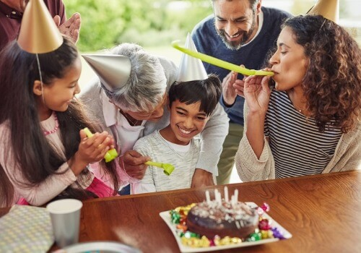

Events In Real Life
Birthday party
Concert

Slide 11
WHAT ARE EVENTS?
HTML events are "things" that happen to HTML elements. When JavaScript is used in HTML pages, JavaScript can "react" on these events.
1.The user clicks or hover the cursor over a certain element
2.The user Choose a key on the keyboard
3.A form is submitted
4.A video is played , paused or finishes
5.A web page is finished loading
6.An error occurs

Slide 12
WHAT ARE EVENTS?
HTML events are "things" that happen to HTML elements. When JavaScript is used in HTML pages, JavaScript can "react" on these events.
1.The user clicks or hover the cursor over a certain element
2.The user Choose a key on the keyboard
3.A form is submitted
4.A video is played , paused or finishes
5.A web page is finished loading
6.An error occurs

Slide 13
WHAT ARE EVENTS?
HTML events are "things" that happen to HTML elements. When JavaScript is used in HTML pages, JavaScript can "react" on these events.
1.The user clicks or hover the cursor over a certain element
2.The user Choose a key on the keyboard
3.A form is submitted
4.A video is played , paused or finishes
5.A web page is finished loading
6.An error occurs

Slide 14
Common HTML Events ?
1.onclick
2.onchange
3.onmouseover
4.onkeydown
5.onload
6.onblur

Slide 15
The 2 ways of handling JS Events ?
1.By using an event handler
2.By using an event listener

Slide 16
BONUS
Event Bubbling
Event Delegation

Slide 17

Thank you!

